Slide 1


“GoGrocers” – Online grocery shopping App
presented by
Ashwini p. Palve(229013)
Komal D. Ghorpade(229039)

Slide 2
Contents
INTRODUCTION
ABSTRACT
EXISTING AND PROPOSED SYSTEM
SOFTWARE EXPLORES
- Software Requirements
- Hardware Requirements
SYSTEM ARCHITECTURE

Slide 3
MODULES
- User : Admin , Employee , Customer , Delivery Person
- Product
- Categories
- Cart
- Order
- Payment
- Delivery
DATAFLOW DIAGRAM
UML DIAGRAM
- E – R Diagram
- Use Case Diagram
- Class Diagram
- Activity Diagram
- Sequence Diagram
TABLES
SCREENSHOTS
CONCLUSION
REFRENCE

Slide 4
INTRODUCTION
This project is a web-based grocery shopping system for an existing shop. An Online Grocery Shopping Management System where the Admin can Add, Update and Delete products.
The Products are divided into various categories like Bakery, Oils and solids , Biscuits , Vegetables , Grains etc. A user can select a particular product to view the details, choose the number of product and fill in details like Name, Address, etc. to buy a product the project objective is to deliver the online grocery shopping application into web platform.
The objective of the project is to make an application platform to purchase grocery items in an existing shop. In order to build such an application complete web support, need to be provided. A complete and efficient web application which can provide the online shopping experience is the basic objective of the project.

Slide 5
ABSTRACT
This project is an attempt to provide the advantages of online shopping to customers of a real shop. It helps buying the products in the shop anywhere through internet by using a website device.
Thus, the customer will get the service of online shopping and home delivery from his favorite shop.
This system can be implemented to any shop in the locality or to multinational branded shops having retail outlet chains.
If shops are providing an online portal where their customers can enjoy easy shopping from anywhere, the shops won’t be losing any more customers to the trending online shops such as Flipkart or e-bay.

Slide 6
EXISTING SYSTEM
In the existing system , most of the work is done manually by using paper and records .
It is a place where we get all our daily use use basic requirement products . This is one of the difficult job to administrate . Most of these works are done by manually .
This includes many drawbacks , Increases the paperwork , Time consuming , Loss of information , Security Issues , Lack of integrated resources , Data duplication etc.

Slide 7
PROPOSED SYSTEM
GoGrocers – online grocery shopping spare you the time of going to your local store and wait for your turn to place the order .
Moreover, you get exotic and gourmet items in an Online Grocery Shopping that you would not get in your locality unless you visit a mall , which may very well be in a distant area .
The best part of online grocery shopping online is that you get free home delivery , which your local shop owner would not offer.
Our system

Slide 8
SOFTWARE EXPLORES
HARDWARE REQUIREMENTS :
- Processor : Intel dual Core.
- HDD : Minimum 500GB Disk Space.
- RAM : Minimum 4GB.
- OS : Windows 10 , 11.
SOFTWARE REQUIREMENTS :
- Java Spring Boot API
- DATABASE : MySQL 8.0
- Java SE 11
- Java jdk 3.9.18

Slide 9
TECHNOLOGY USED
FRONTEND TECHNOLOGY :
- REACTJS , HTML5 , CSS , BOOTSTRAP .
BACKEND TECHNOLOGY :
- JAVA SPRING BOOT API .
DATABASE
- MYSQL 8.0

Slide 10
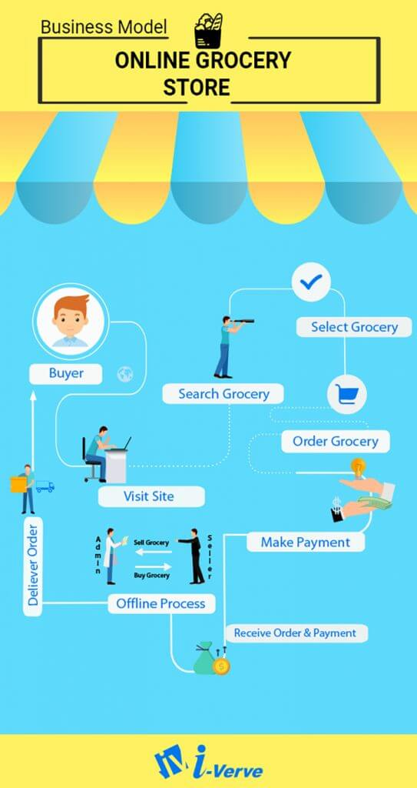
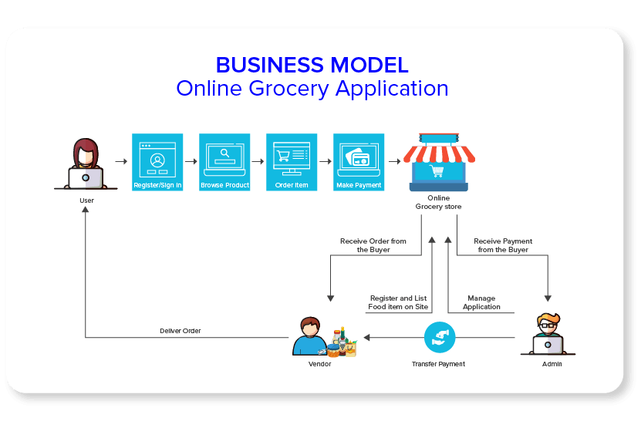
SYSTEM ARCHITECTURE

Slide 11
mODULES
User : Admin , Employee , Customer , Delivery Person
Product
Categories
Cart
Order
Payment
Delivery

Slide 12
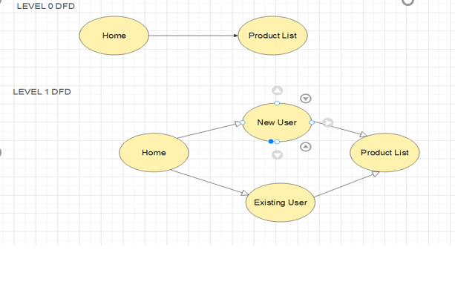
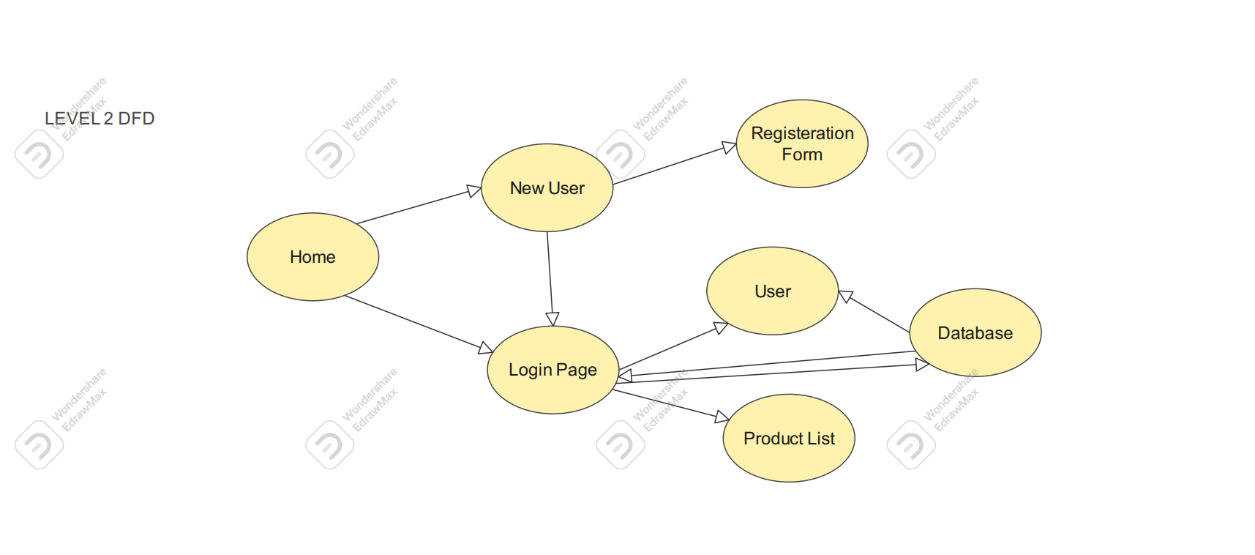
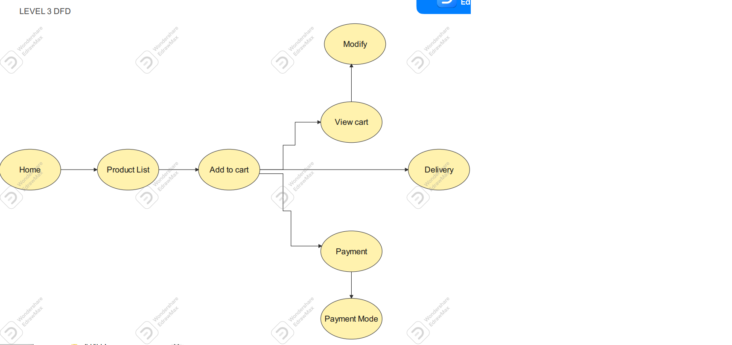
DATAFLOW DIAGRAM

Slide 13
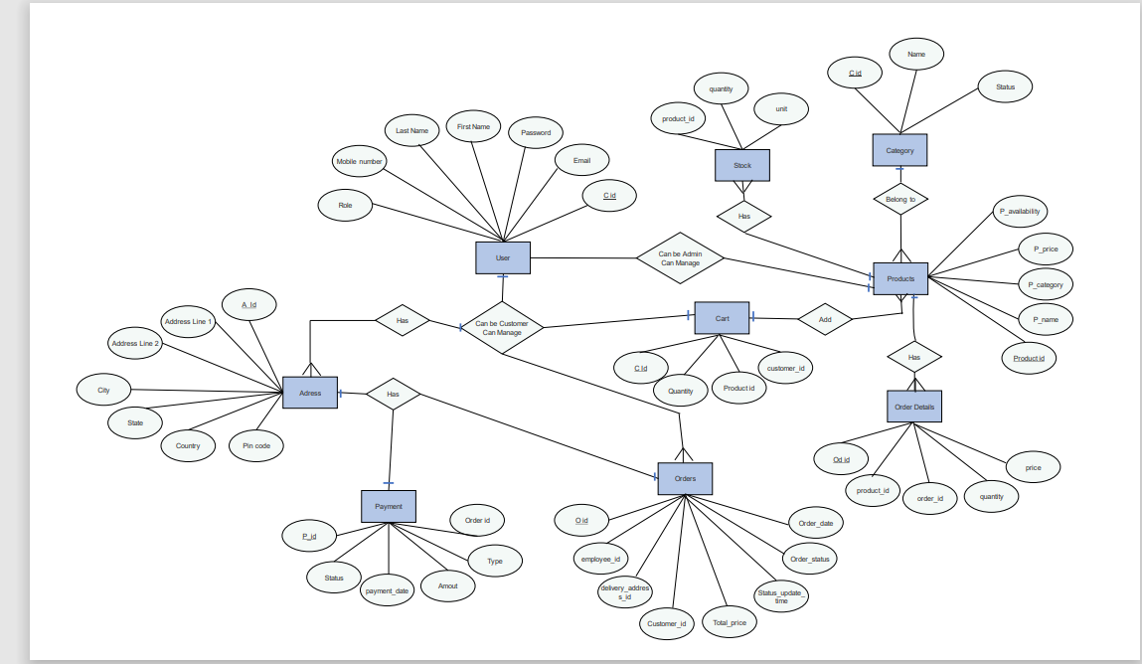
UML DIAGRAM
E – R DIAGRAM

Slide 14
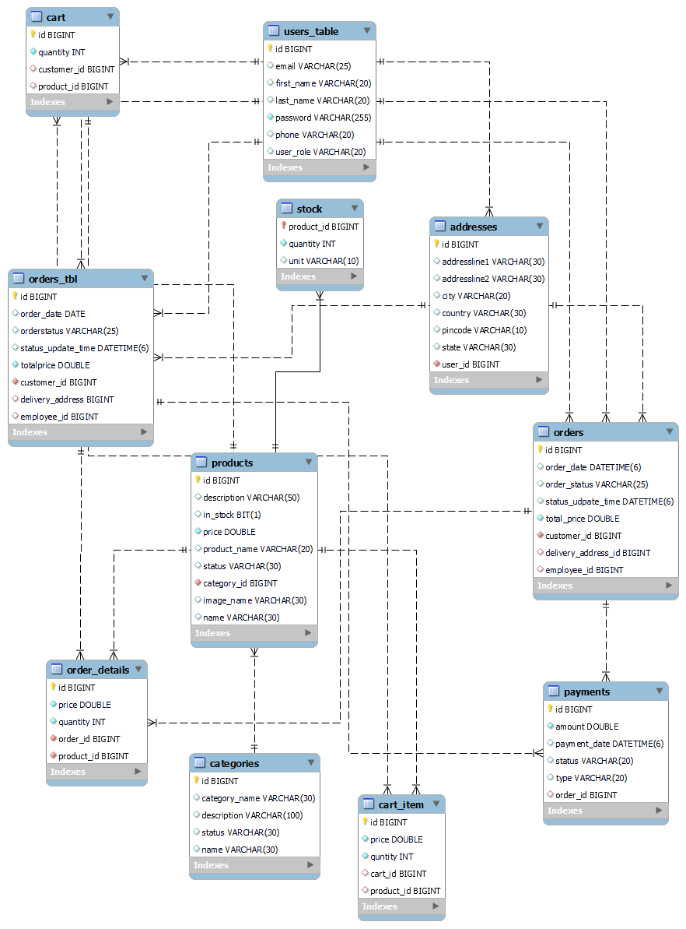

Slide 15
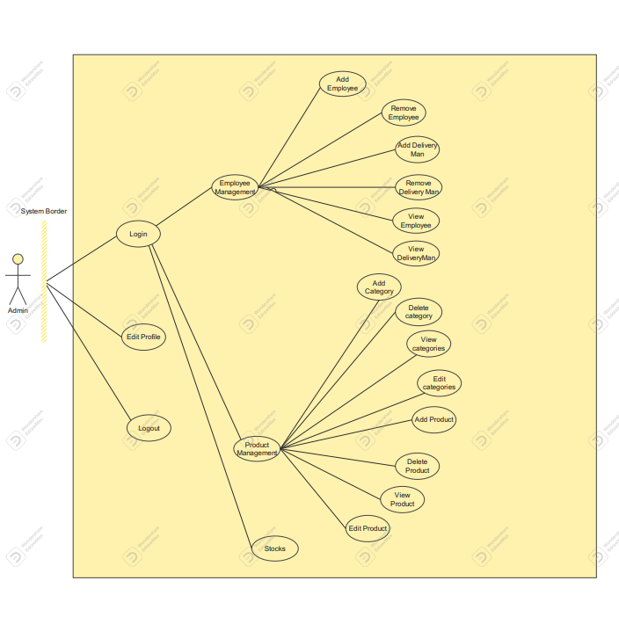
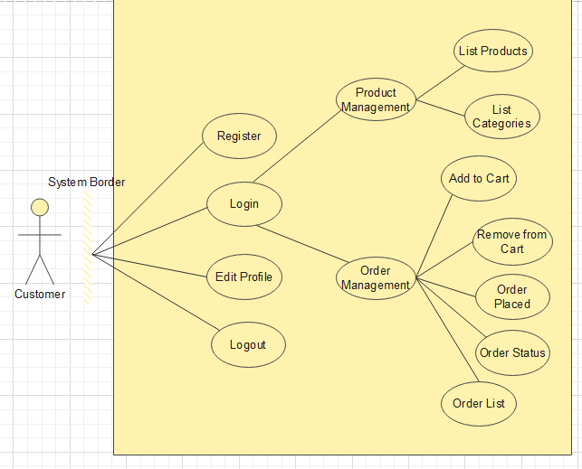
USE CASE DIAGRAM

Slide 16
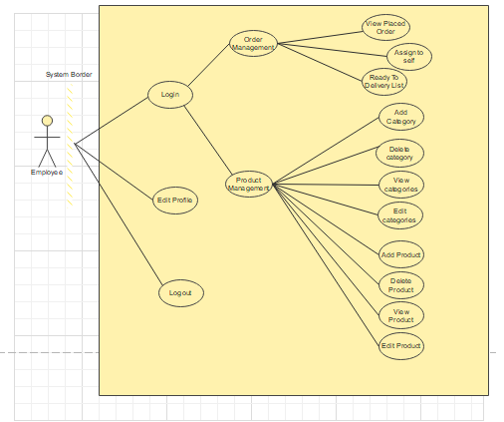
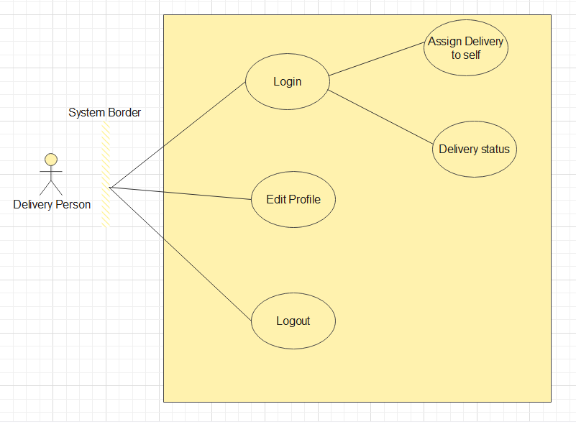

Slide 17
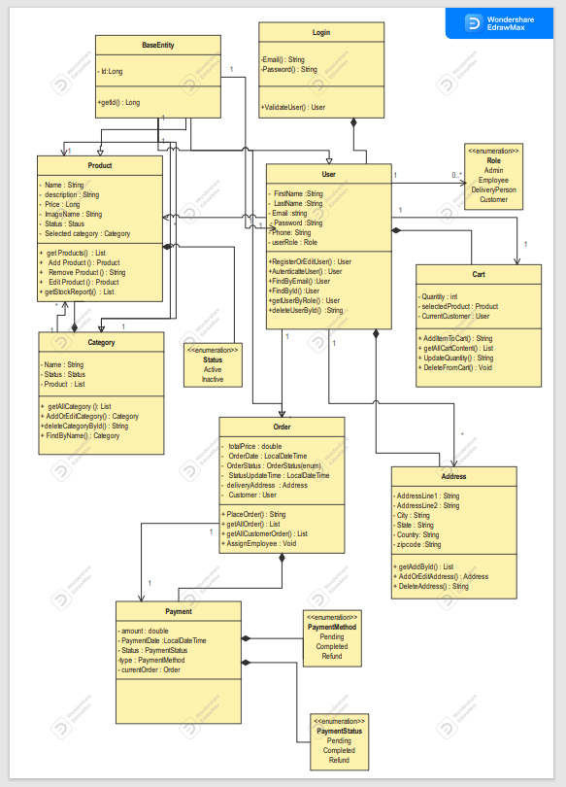
CLASS DIAGRAM

Slide 18
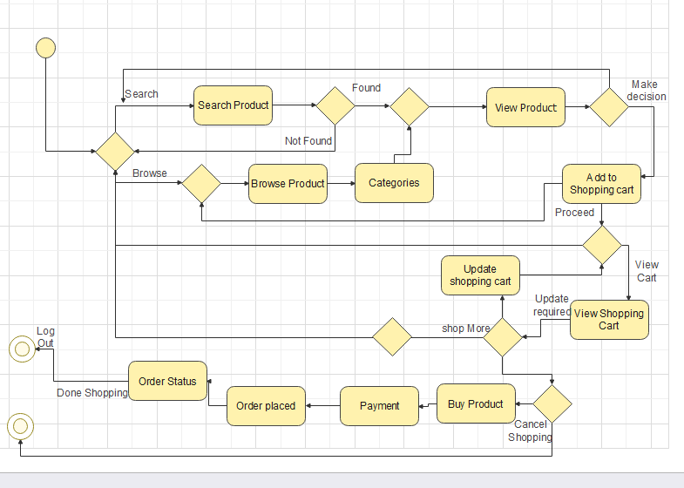
ACTIVITY DIAGRAM

Slide 19
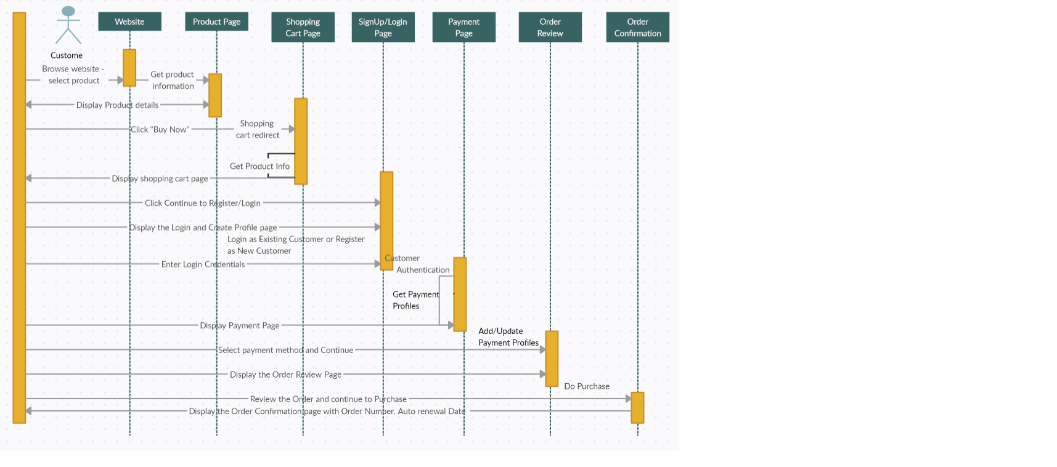
SEQUENCE DIAGRAM

Slide 20
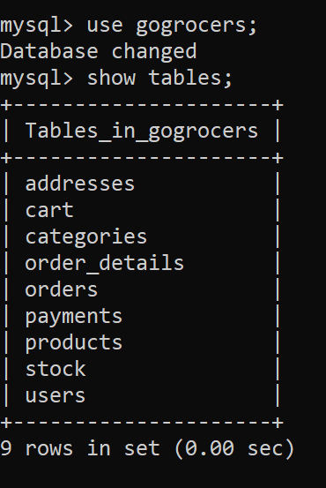
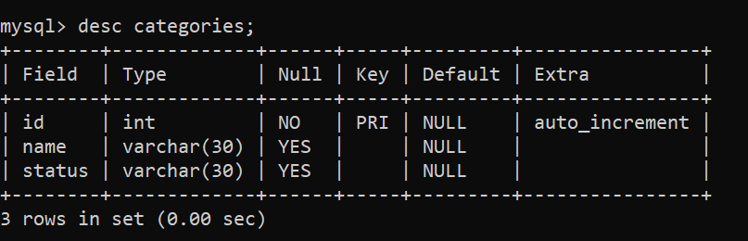
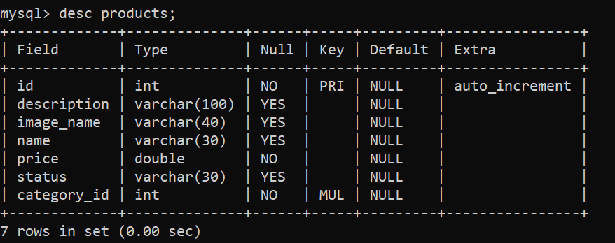
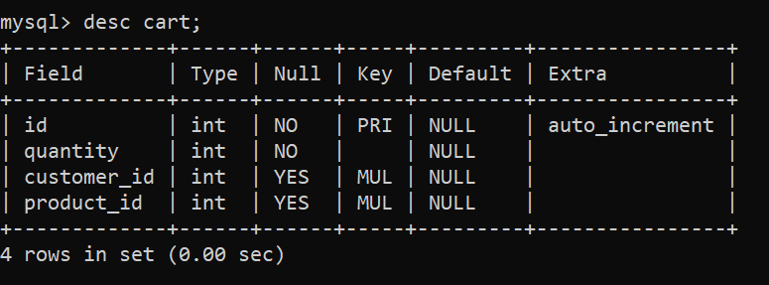
TABLES
1)List of Table:
2)Categories Table
3)Products Table:
4)Cart Table:

Slide 21
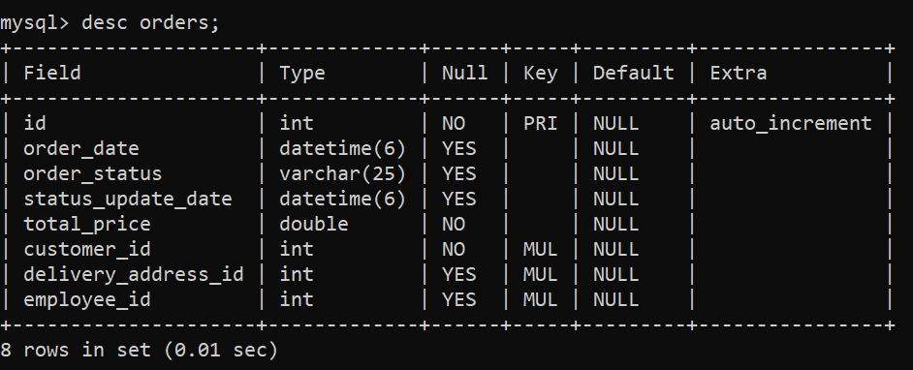
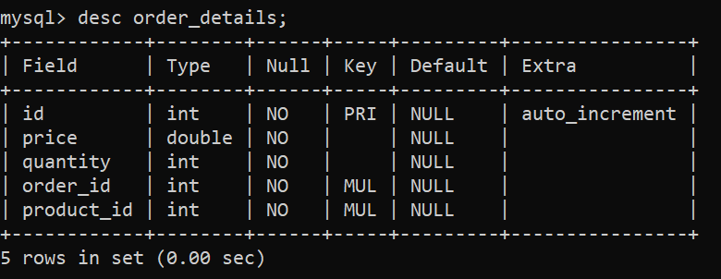
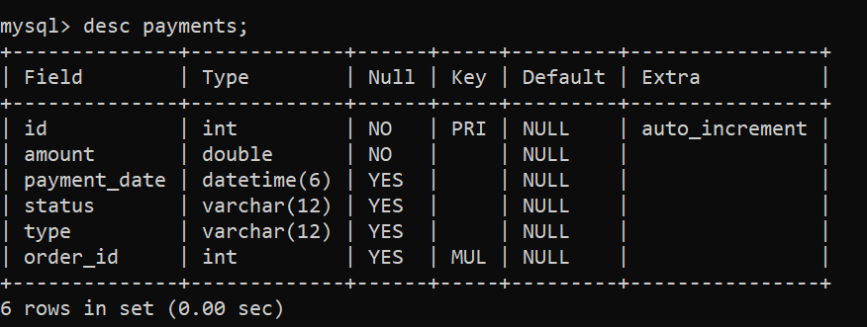
5) Orders Table:
6) Orders_details Table:
7) Payments Table:

Slide 22
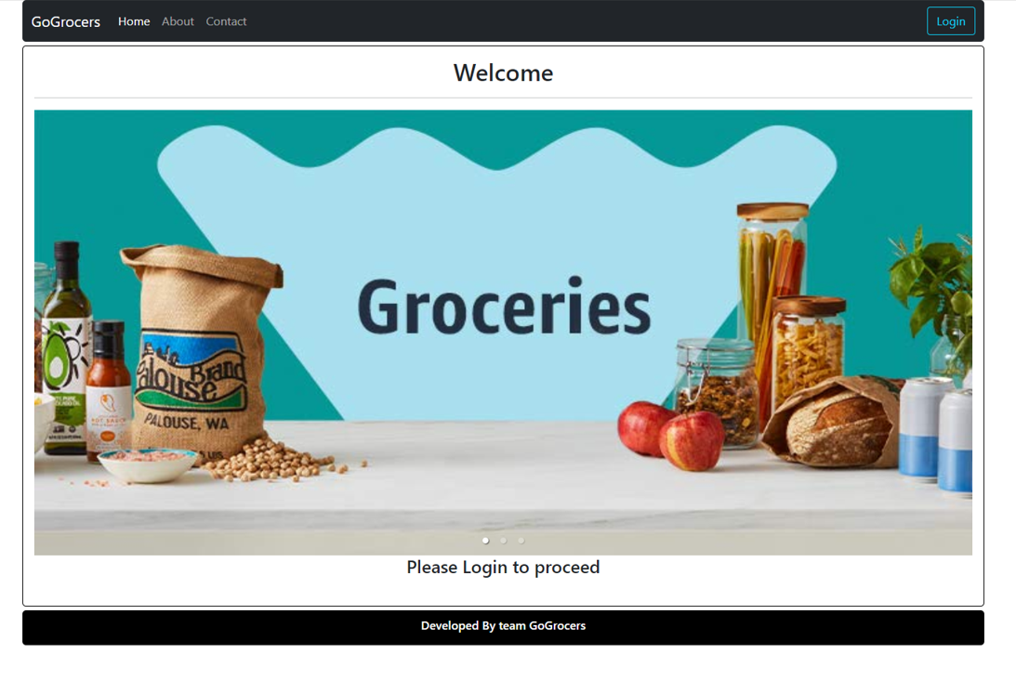
SCREENSHOTS

Slide 23
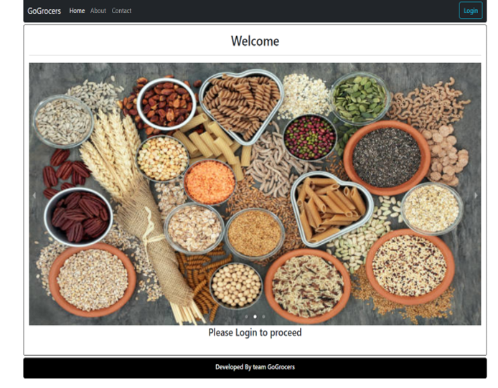
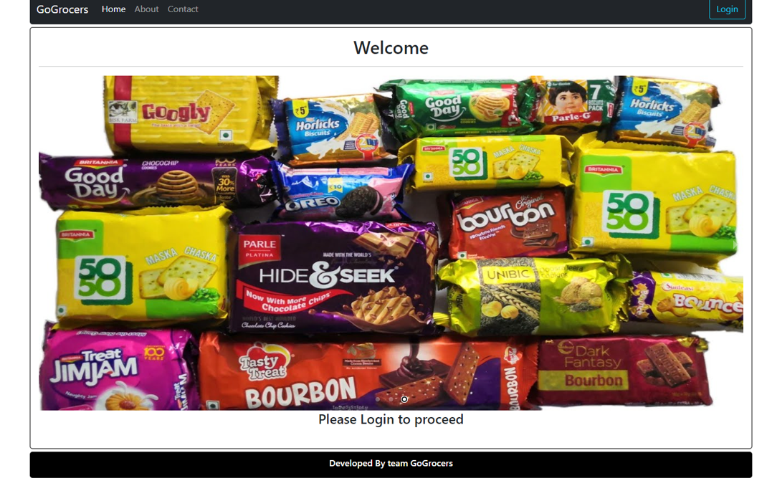
Welcome Page Of GoGrocers

Slide 24
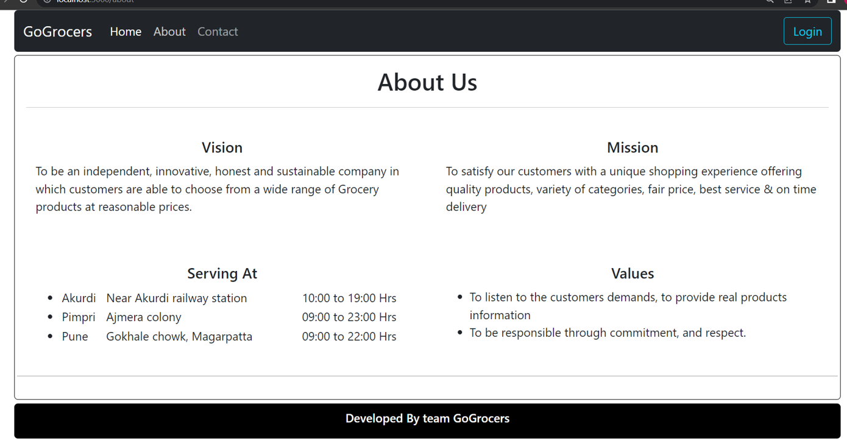
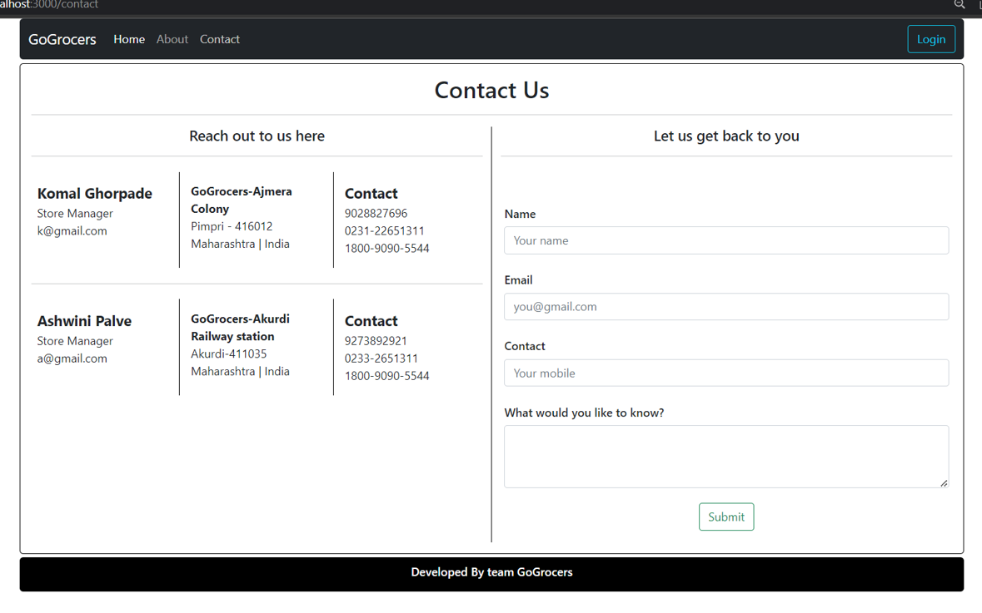

Slide 25
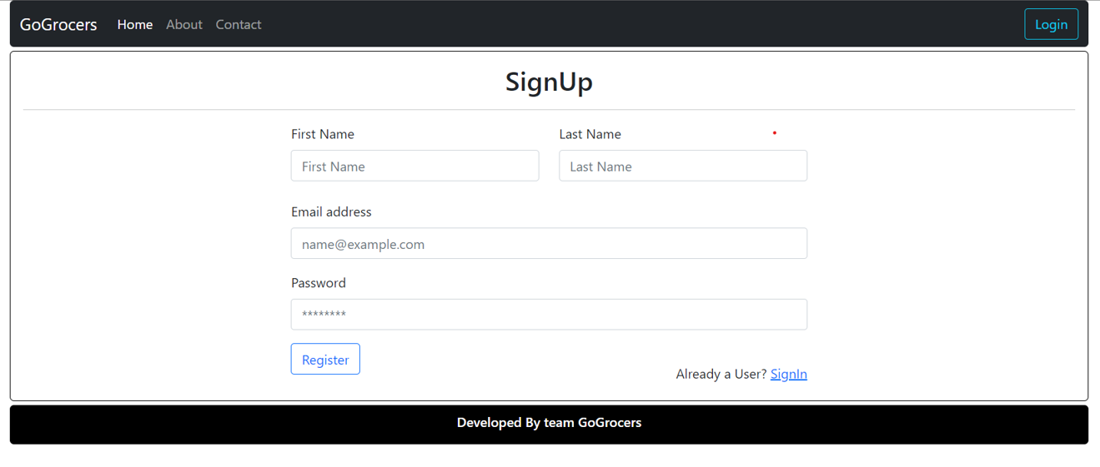

Slide 26
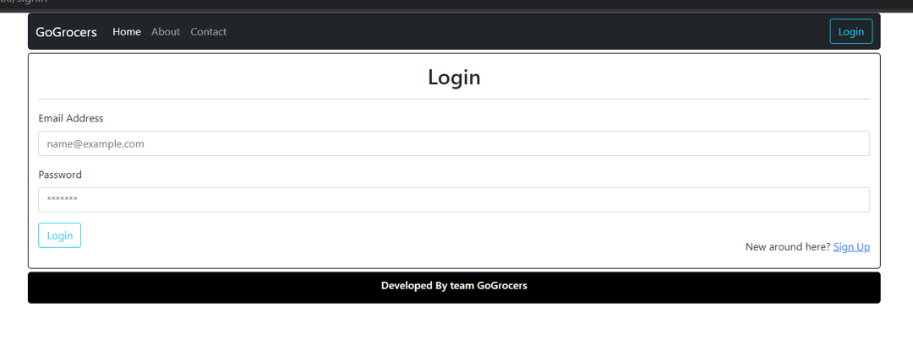
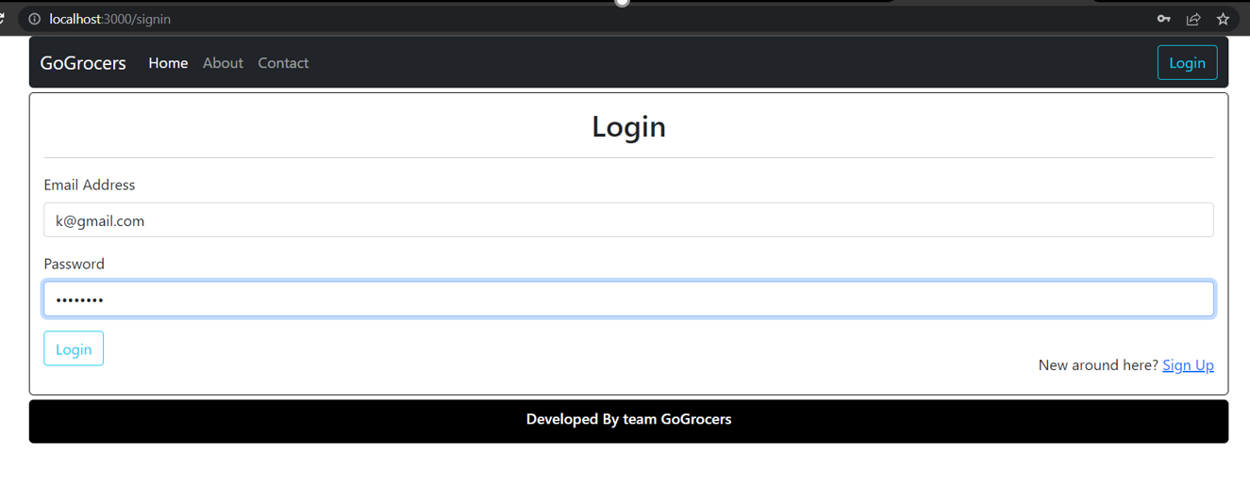

Slide 27
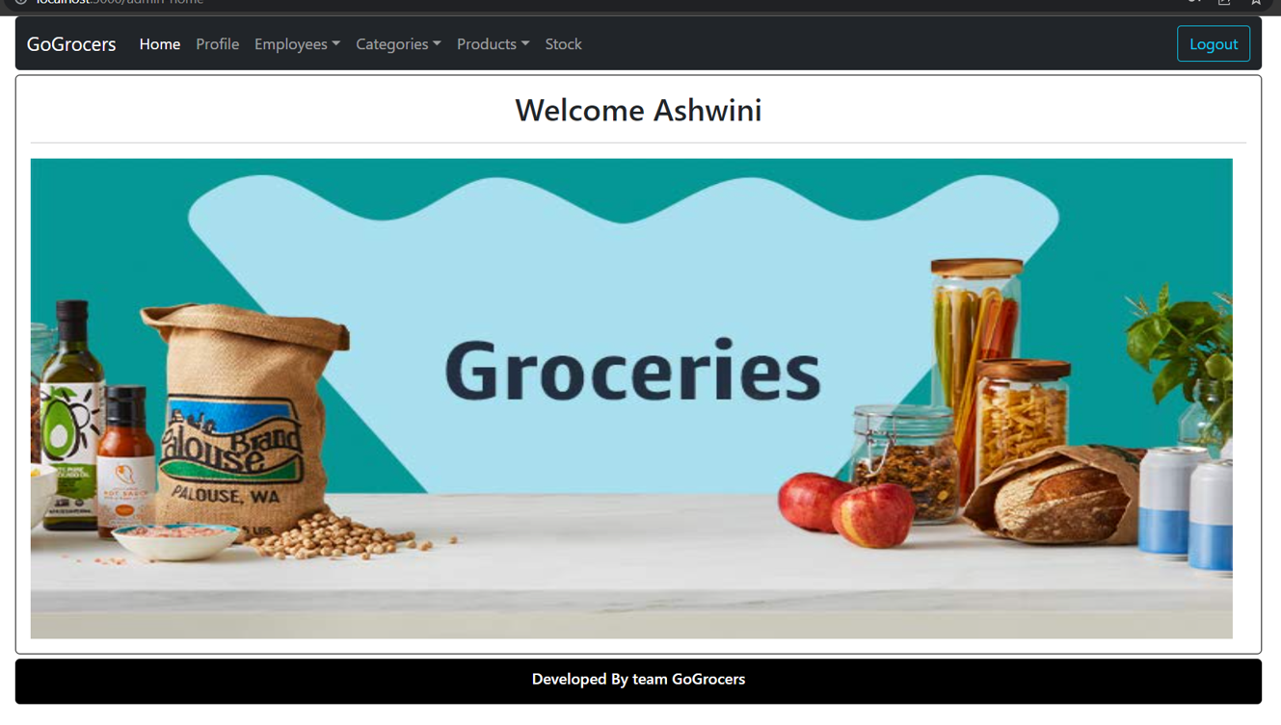
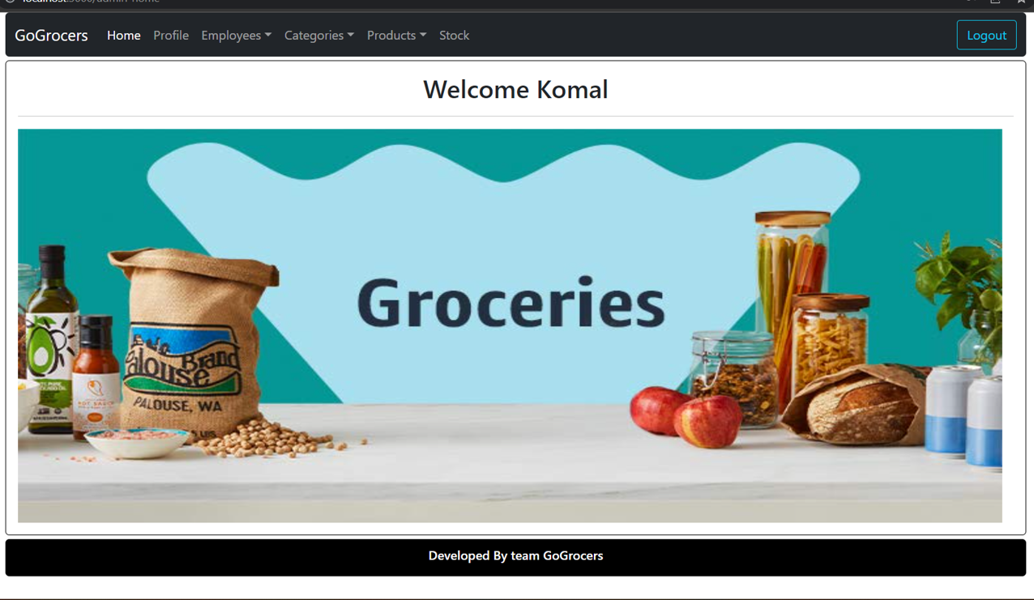
Admin Login:

Slide 28
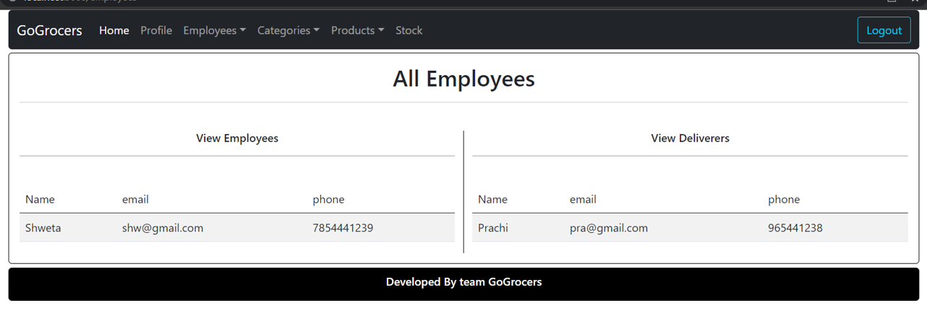
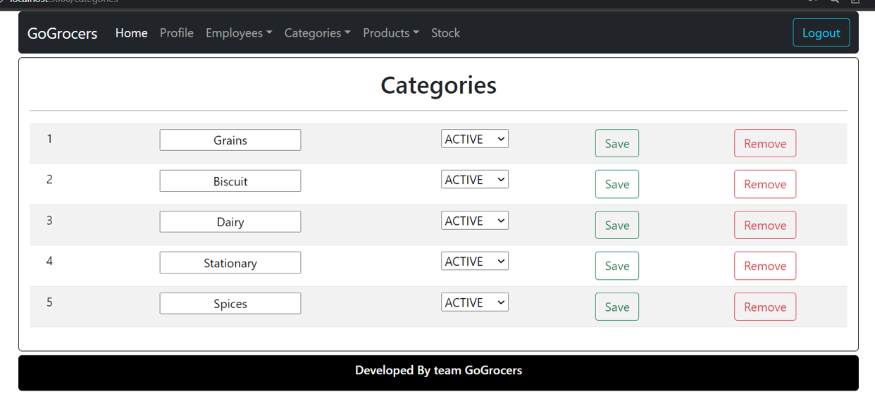

Slide 29
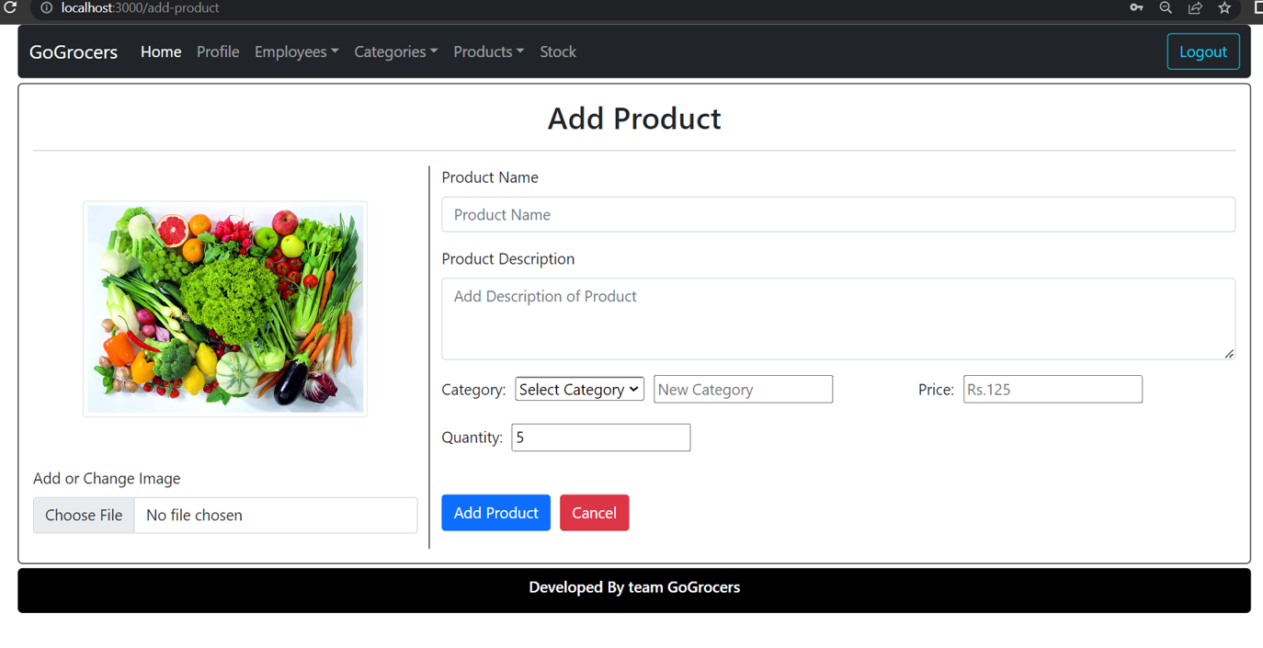

Slide 30
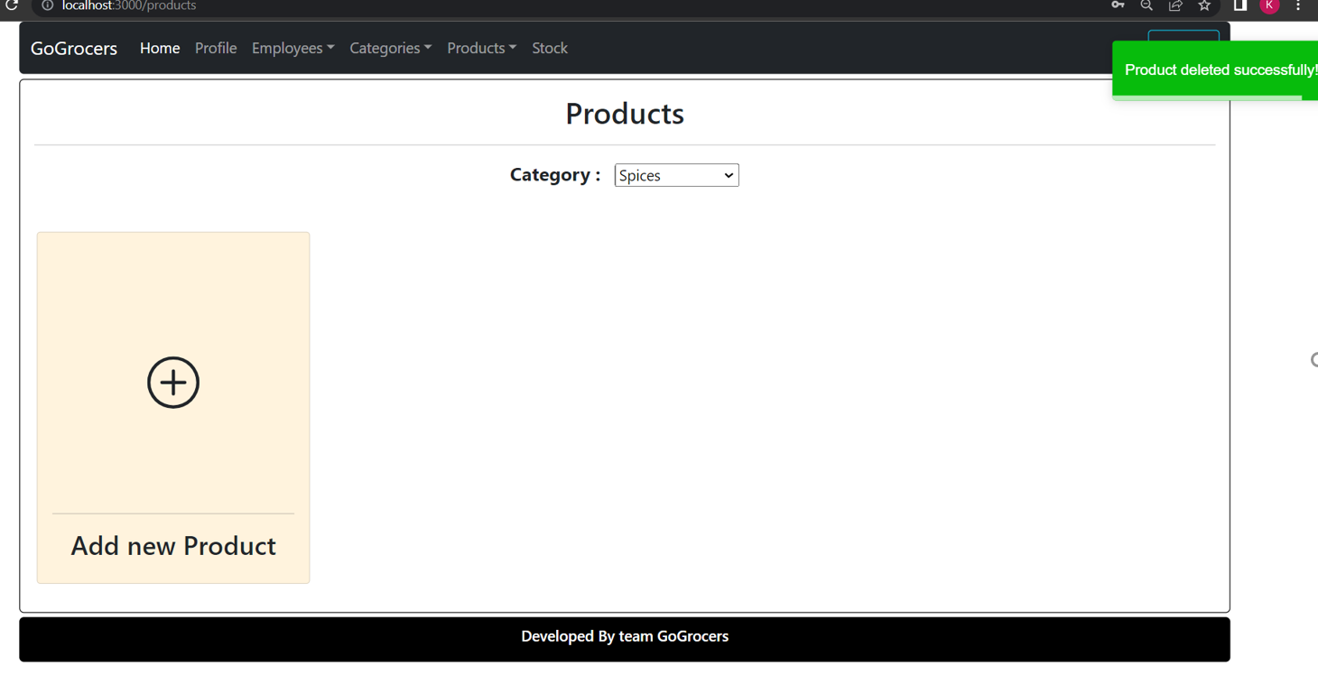

Slide 31
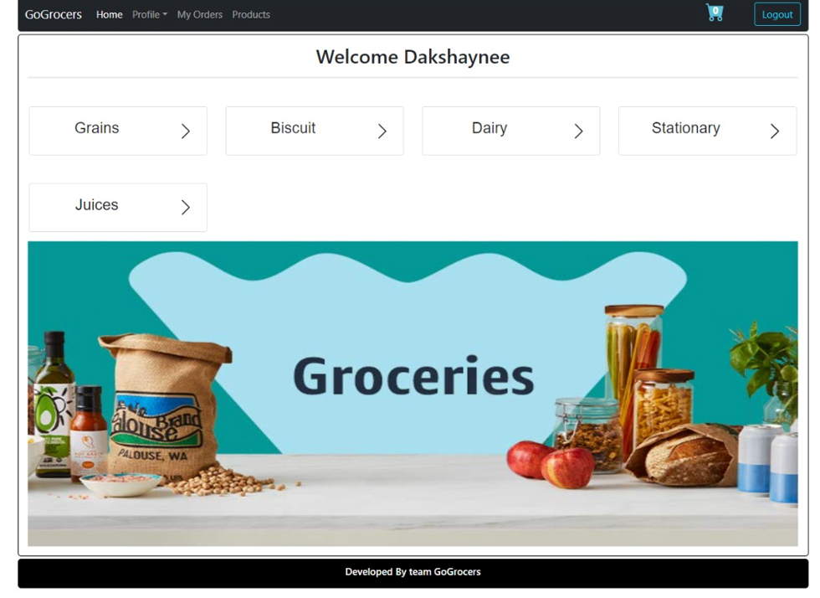
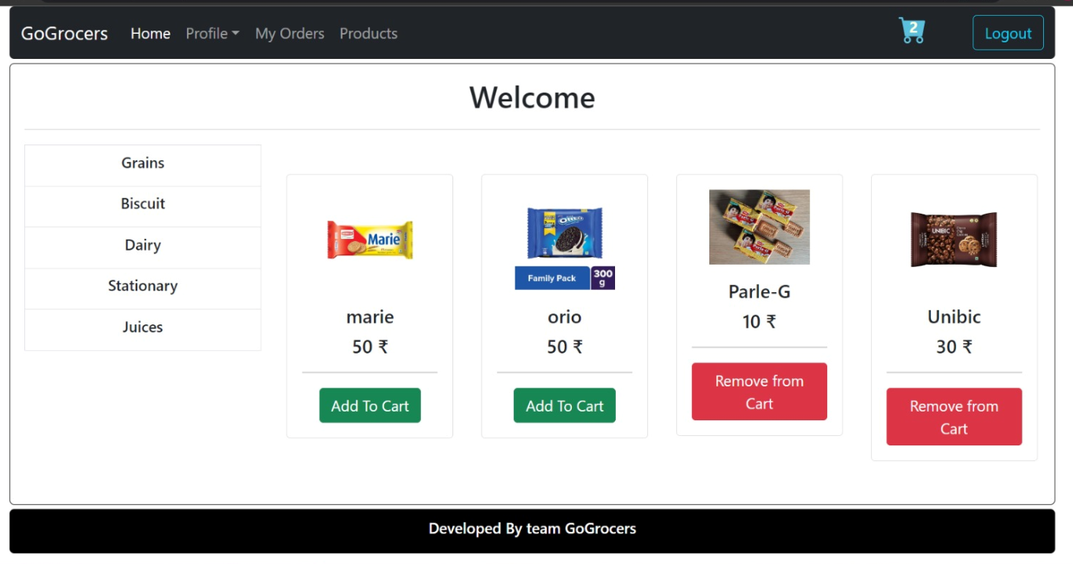
Customer Login :

Slide 32
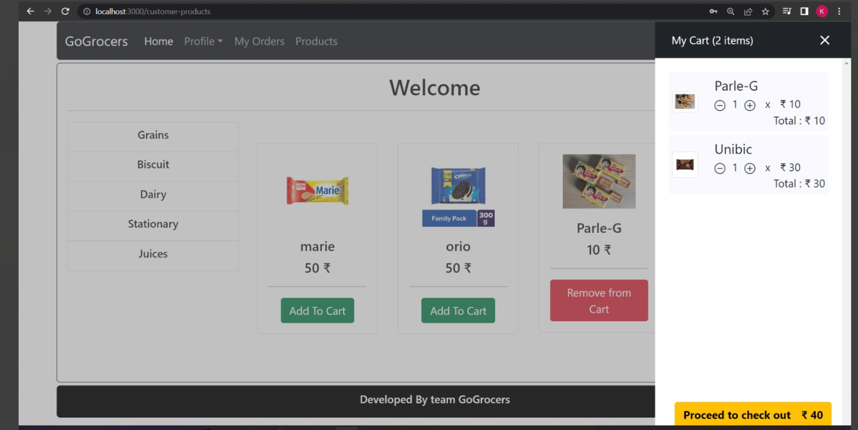
Customer Adding Product to cart :

Slide 33
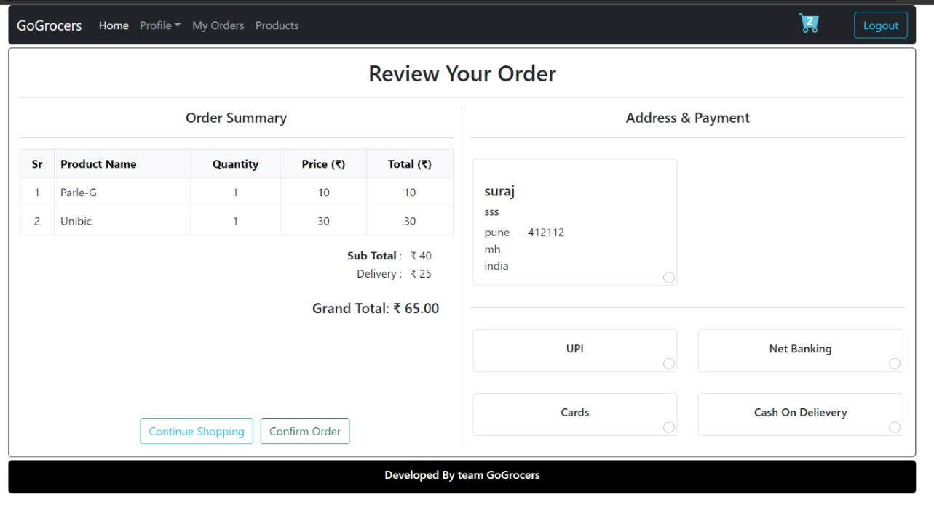
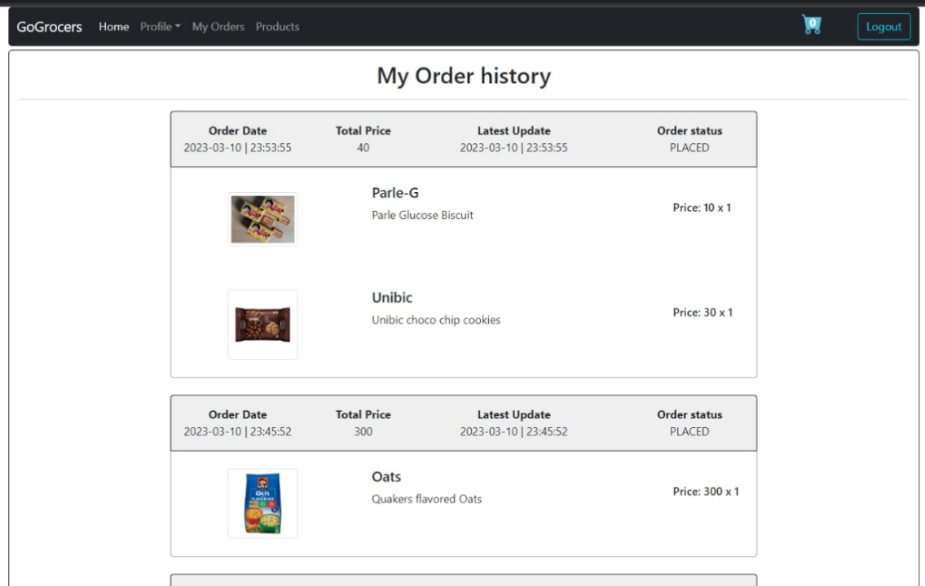
Customer Orders review and history :

Slide 34
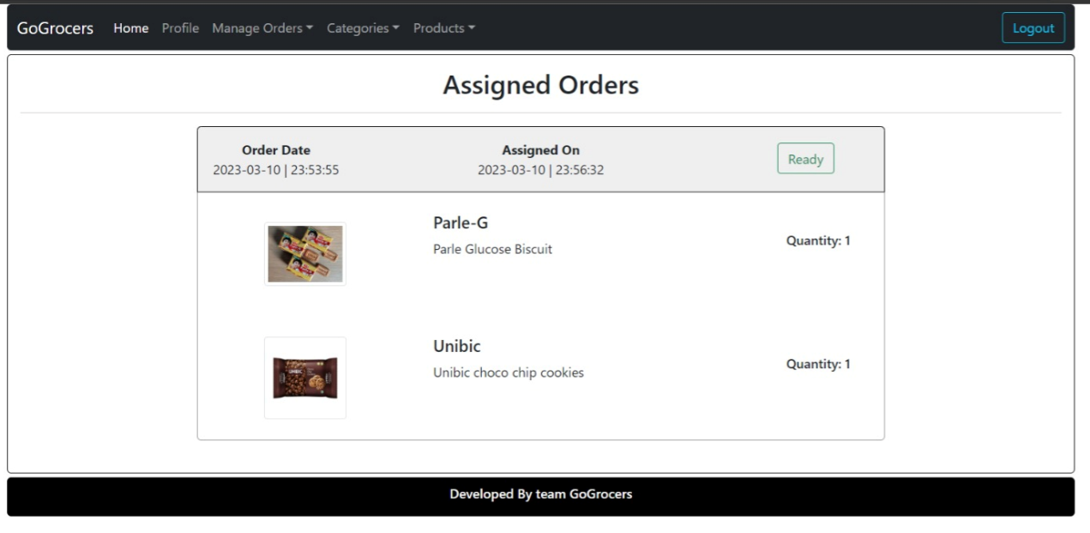
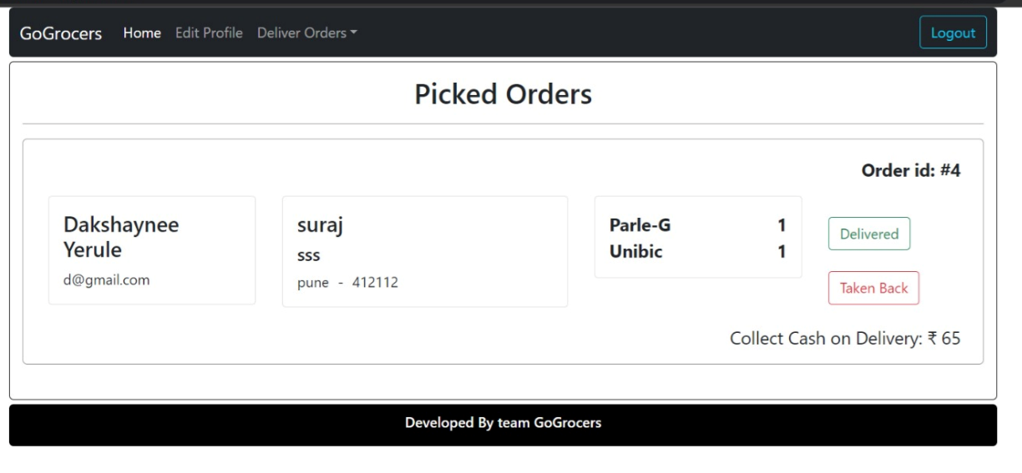
Delivery Person Login :

Slide 35
ADVANTAGES
Ability to handle multiple purchases .
Automation minimizes human error .
Lower costs of store maintenance .
You can retarget the customers .
Detailed product information .
Ecommerce save time for a customer

Slide 36
DISADVANTAGES
Compulsory registration .
Some items are hard to purchase online .
Waiting for a product to be delivered .
Security issue .

Slide 37
FUTURE SCOPE
There is a scope for further development in our project to a great extent . A number of features can be added to this system in future like providing moderator more control over products so that each moderator can maintain their own products .
Another feature we wished to implement was providing classes for customers so that different offers can be given to each class .
System may keep tracks of History of purchases of each customer and provide suggestions based on their history . These features could have implemented unless the time did not limit us.

Slide 38
CONCLUSION
By Implementation this grocery store management system we getting more flexible to the user .
Which can operate from the home itself implementing the pay ,pickup and pay now option .
Technology has made significant progress over the years to provide consumers a better online shopping experience and will continue to do so for years to come.
However, the availability of online shopping has produced a more educated consumer that can shop around with relative ease without having to spend a large amount of time. In exchange, online shopping has opened up doors to many small retailers that would never be in business if they had to incur the high cost of owning a brick and mortar store.
At the end, it has been a win-win situation for both consumer and sellers.

Slide 39
REFRENCES
[1] JavaScript Enlightenment, Cody Lindley-First Edition, based on JavaScript 1.5, ECMA-262, Edition
[2] Mc Graw Hill’s, Java: The complete reference 7thEdition, Herbert Scheldt
[3] Complete CSS Guide, Maxine Sherrin and John Allsopp - O'Reilly Media; September 2012
ONLINE REFERENCE :
[1] www.Google.com
[2] www.w3school.com
[3] www.javatpoint.com

Slide 40
Thank you !!!

